Slide 1
Survey data analysis Week 49: “Inference for non-probability samples”
© Peter Lugtig

Slide 2
Today
Lecture
Inference ‘competition’

Slide 3
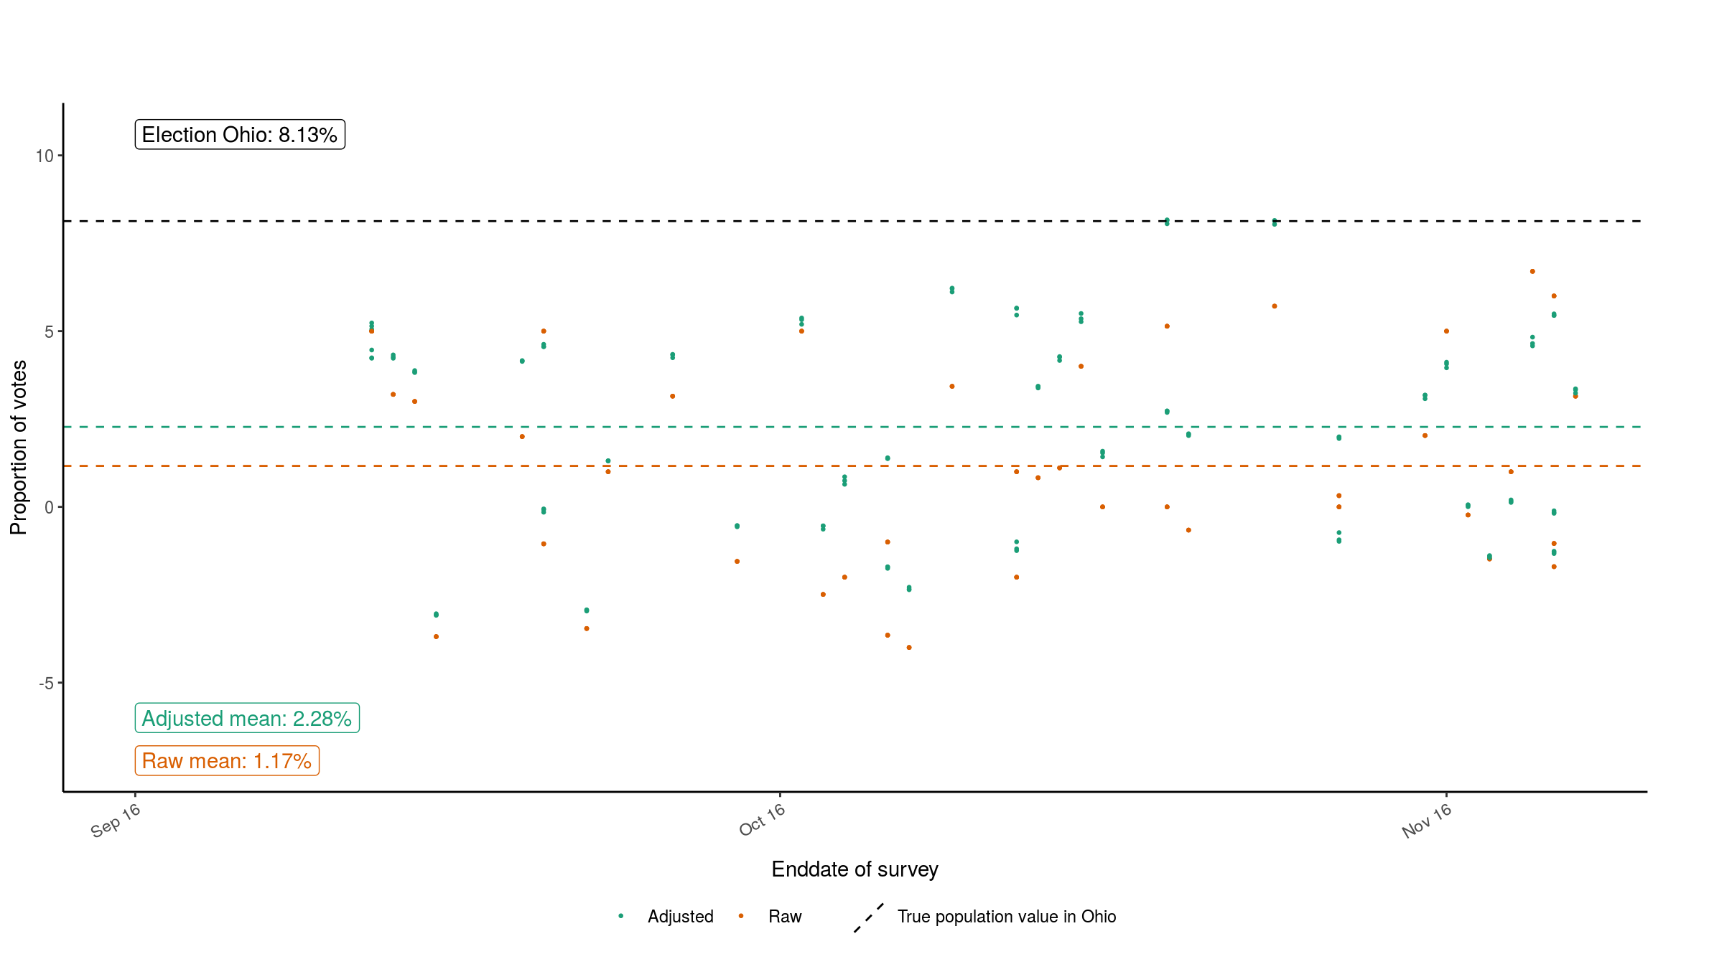
Back to week 37 (1)
See: https://utrecht-university.shinyapps.io/SDA_shinyelectionbias/

Slide 4
Back to week 37 (1)
Adjustments only help a bit on average
For individual polls they sometimes make matters worse!

Slide 5
Back to week 37 (1)
Adjustments only help a bit on average
For individual polls they sometimes make matters worse!
Grade of pollster/ sample size/ population dont make the difference

Slide 6
We have an inference problem
Adjustments only help a bit on average
For individual polls they sometimes make matters worse!
Grade of pollster/ sample size/ population dont make the difference
Problems with weighting
A lot of polls are not probability based

Slide 7
Three articles today
Cornesse et al (2020)
Mercer et al (2018)
Meng (2018)
What are the differences between their views?

Slide 8
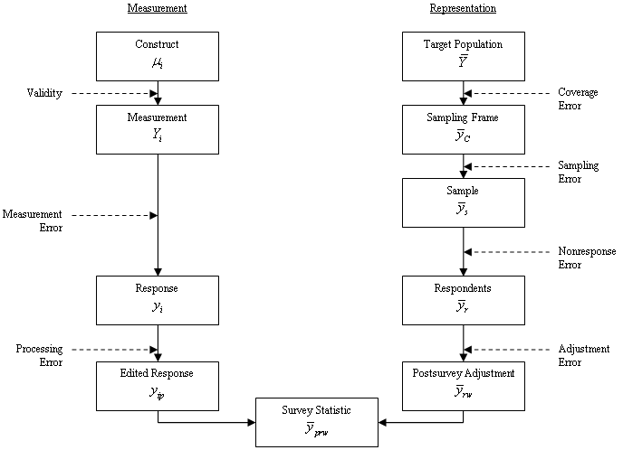
Selection bias vs. TSE
(Groves et al. 2009, p.48)

Slide 9
Cornesse et al (2020)
Non-probability surveys do worse than probability ones
Fit for purpose
In what situation is a non-probability sample not too bad? (in pairs – 3 minutes)

Slide 10
Cornesse et al (2020)
When is a non-probability sample not too bad?
in change estimates?
(regression models)?
When controls are accurate (quota)
Global adjustment approaches
i.e. Conceptualize as design-based
Estimate-specific approaches
Later in lecture examples)

Slide 11
Mercer et al (2018)
Three conditions for inference (p252)
Exchangeability
Do we have all relevant X covariates that (could) explain selection bias?
Positivity
Do we have all subgroups?
Composition
Can we match sample to the population?
Calibration or other weighting techniques

Slide 12
Mercer et al (2018)
Three conditions for inference (p252)
Exchangeability
Do we have all relevant X covariates that (could) explain selection bias?
Positivity
Do we have all subgroups?
Composition
Can we match sample to the population?
Calibration or other weighting techniques
X
Z
Can you apply these terms to the missing data diagrams? (2 min)
R
Y

Slide 13
Mercer et al (2018)
Three conditions for inference (p252)
Exchangeability
Do we have all relevant X covariates that (could) explain selection bias?
Positivity
Do we have all subgroups?
Composition
Can we match sample to the population?
Calibration or other weighting techniques
X
Z
Can you apply these terms to the missing data diagrams? (2 min)
R
Y

Slide 14
Inference: perspectives from other fields
Natural sciences
Laws of nature: gravity works everywhere
Representation error not an issue
Social sciences broadly
We need descriptives about our population and models about the world
External validity
More sociological
We want to test causal mechanisms
Internal validity
More psychological

Slide 15
Mercer et al (2018)
Experiments
Strong ignorability (random assignment)
Exchangeability and
Positivity
Transportability: composition?
Can we match sample to the population?
Not considered an issue in inference
WEIRD samples

Slide 16
Mercer et al (2018)
Design-based surveys
Random samples leads to ignorability
Exchangeability and
Positivity
And to transportability
Only sampling error
Nonresponse and coverage error
Weighting fixes exchangeabilty
Positivity assumed (subgroups are al there)

Slide 17
Mercer et al (2018)
Non-prob surveys and what to do?
Exchangeability (we need the right X vars)
Positivity (we need to have all subgroups
Composition

Slide 18
Meng 2018 – linking data quality,quantity
ρ(R,G): correlation between selection bias (R) and variable of interest
𝛔(G): variation in population of variable of interest
E.g. If everyone votes for Clinton, no problem
Data quantity:
f=sampling fraction from population.
P. 690 (eq 2.3)

Slide 19
Meng 2018 – linking data quality,quantity
R mechanism (response)
Design based
Sampling probabilities are known
Nonresponse propensities are modeled.
Non-probability: selection probabilities are unknown
G: estimate of interest (e.g. a mean)
Y in missing data literature
If correlation [R,G] = 0, no problem with any data
If R does not vary over elements, no problem

Slide 20
Meng 2018 – final
When can we draw inferences for Big Data (non-probability samples)?
Data quality: ρ(R,G): 0
design based philosophy
Quality and quantity are independent (?)
Data quantity: f very large (close to 1)
Big data philosophy
Quality and quantity negatively correlated?
𝛔(G): very small

Slide 21
Now to practice
Exchangeability (Mercer), or ρ(R,G): 0 (Meng)
positivity is a design feature

Slide 22
Solutions
1.Global correction methods
Pseudo design based estimation (Elliott & Valliant 2017)
2. Estimate-specific methods
Calibration (Little, 2004)
non-prob -> probability
Superpopulation modeling (e.g. Elliott & Valliant, 2020)
Mass imputation (Yang and Kim, 2020)
3. Sensitivity analyses
Meng: for ρ(R,G)
Pattern mixture models for NMAR (e.g West 2020)

Slide 23
1. Pseudo design based
non-probability based
gender | age | education | health | Fav ice
0 | 34 | 1 | 5 | vanilla
1 | 54 | 2 | 5 | lemon
1 | 12 | 3 | 4 | Choc
1 | 56 | 3 | 5 | vanilla
0 | 87 | 4 | 2 | strawb
1 | 45 | 5 | 3 | zabaione
1 | 67 | 6 | 4 | lemon
1 | 23 | 6 | 5 | straccia
0 | 16 | 2 | 5 | vanilla
1 | 24 | 4 | 4 | straccia
1 | 56 | 2 | 4 | straccia
1 | 78 | 3 | 2 | vanilla
Taste | percentage
Vanilla | 33%
Lemon | 16%
Straccia | 25%
Zabaione | 8%
Strawberry | 8%
Chocolate | 8%

Slide 24
1.Pseudo design based
non-probability based
Other Probability based survey
gender | age | education | health | Fav ice
0 | 34 | 1 | 5 | vanilla
1 | 54 | 2 | 5 | lemon
1 | 12 | 3 | 4 | Choc
1 | 56 | 3 | 5 | vanilla
0 | 87 | 4 | 2 | strawb
1 | 45 | 5 | 3 | zabaione
1 | 67 | 6 | 4 | lemon
1 | 23 | 6 | 5 | Banana
0 | 16 | 2 | 5 | vanilla
1 | 24 | 4 | 4 | pear
1 | 56 | 2 | 4 | straccia
1 | 78 | 3 | 2 | vanilla
gender | age | education | health | P(Response)
0 | 34 | 1 | 5 | ,24
1 | 54 | 2 | 5 | ,44
1 | 12 | 3 | 4 | .23
1 | 56 | 3 | 5 | .56
0 | 87 | 4 | 2 | ,36
1 | 45 | 5 | 3 | .56
1 | 67 | 6 | 4 | .44
1 | 23 | 6 | 5 | .33
0 | 16 | 2 | 5 | ,32
1 | 24 | 4 | 4 | .43
1 | 56 | 2 | 4 | .42
1 | 78 | 3 | 2 | .43

Slide 25
1.Pseudo design based
non-probability based
gender | age | education | health | P(Response) | Fav ice
0 | 34 | 1 | 5 | ,24 | vanilla
1 | 54 | 2 | 5 | ,44 | lemon
1 | 12 | 3 | 4 | .23 | Choc
1 | 56 | 3 | 5 | .56 | vanilla
0 | 87 | 4 | 2 | ,36 | strawb
1 | 45 | 5 | 3 | .56 | zabaione
1 | 67 | 6 | 4 | .44 | lemon
1 | 23 | 6 | 5 | .33 | straccia
0 | 16 | 2 | 5 | ,32 | vanilla
1 | 24 | 4 | 4 | .43 | straccia
1 | 56 | 2 | 4 | .42 | straccia
1 | 78 | 3 | 2 | .43 | vanilla
Taste | Raw percentage | Weight (1/p)
Vanilla | 33% | 1/.39
Lemon | 16% | 1/.44
Straccia | 25% | 1/.39
Zabaione | 8% | 1/.56
Strawberry | 8% | 1/.36
Chocolate | 8% | 1/.23

Slide 26
1.Pseudo design based
non-probability based
gender | age | education | health | P(Response) | Fav ice
0 | 34 | 1 | 5 | ,24 | vanilla
1 | 54 | 2 | 5 | ,44 | lemon
1 | 12 | 3 | 4 | .23 | Choc
1 | 56 | 3 | 5 | .56 | vanilla
0 | 87 | 4 | 2 | ,36 | strawb
1 | 45 | 5 | 3 | .56 | zabaione
1 | 67 | 6 | 4 | .44 | lemon
1 | 23 | 6 | 5 | .33 | straccia
0 | 16 | 2 | 5 | ,32 | vanilla
1 | 24 | 4 | 4 | .43 | straccia
1 | 56 | 2 | 4 | .42 | straccia
1 | 78 | 3 | 2 | .43 | vanilla
Taste | Raw percentage | Weight (1/p) | Weighted %
Vanilla | 33% | 1/.39 | 33%
Lemon | 16% | 1/.44 | 14%
Straccia | 25% | 1/.39 | 24%
Zabaione | 8% | 1/.56 | 6%
Strawberry | 8% | 1/.36 | 9%
Chocolate | 8% | 1/.23 | 14%
Ave |  | .40

Slide 27
2. Estimate specific methods
2.1 Calibration (Little, 2004)
2.2 Superpopulation modeling (e.g. Elliott & Valliant, 2020)
2.3 Mass imputation (Yang and Kim, 2020)

Slide 28
2.1 Calibration
Conduct a large nonprobability sample
Small s.e., large bias(?)
Conduct a small probability based sample
Large s.e., small bias
Weight non-probabity based -> prob based
Small bias (?), small s.e.
You can use lots of survey questions, because you conduct 2 surveys
Expensive, time consuming

Slide 29
2.1 Little (2004) Calibrated bayes
Model based (regression) vs. design based
Solution:
Use a model that includes design-based features
E.g. A fixed-effects regression model to deal with clustering
Bayesian modeling for variance estimation
Priors (often uninformative)
Posteriors for variance estimation
Remember convergence, traceplots,, and how imputations are generated in Mice?

Slide 30
2.2 Superpopulation modeling
Non-probability based surveys don’t use sample frames
We can rake or calibrate to population statistics:
gender, age, region, ethnicity, income, etc…
Idea is to collect more population statistics
Netflix subscription, voting Behavior, customer of a company, member of organization, ….

Slide 31
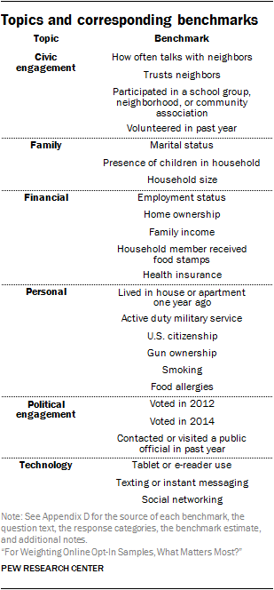
2.2 Superpopulation modeling
Approach by Mercer (2017)
Netflix subscription? Voting Behavior, customer of a company, member of organization
i.e. More elaborate weighting
Source:https://www.pewresearch.org/methods/2018/01/26/reducing-bias-on-benchmarks/

Slide 32
2.3 Mass imputation
We know the population distribution:
Gender, age, education, income, region, etc.
In some cases we have frame data
Why not impute the whole population?

Slide 33
Mass imputation
gender | age | education | health | Fav ice
0 | 34 | 1 | 5 | vanilla
1 | 54 | 2 | 5 | lemon
1 | 12 | 3 | 4 | Choc
1 | 56 | 3 | 5 | vanilla
0 | 87 | 4 | 2 | strawb
1 | 45 | 5 | 3 | zabaione
1 | 67 | 6 | 4 | lemon
1 | 23 | 6 | 5 | straccia
0 | 16 | 2 | 5 | vanilla
1 | 24 | 4 | 4 | straccia
1 | 56 | 2 | 4 | straccia
1 | 78 | 3 | 2 | ???
1 | 56 | 4 | 5 | ???
…. | … | … | .. | ???
You have X million rows, only X thousand of thesehave Y
We know the population distribution:
Gender, age, education, income, region, etc.
In some cases we have frame data
Why not impute the whole population?

Slide 34
3. Sensitivity analyses
Cf Meng (2018)
Pattern Mixture modeling
Enter an additional parameter in the model (e.g a selection bias parameter)
This parameter can take different forms
Covary with Y and all other parameters
Simulate
Similar to Heckman selection models.
See Andridge, R. R., & Little, R. J. (2011). Proxy pattern-mixture analysis for survey nonresponse. Journal of Official Statistics, 27(2), 153.

Slide 35
Exercise (class + THE)
Competition!
Three non-probability samples
Sample size 30.000
June/July 2016
You get 15.000 cases
And a superpopulation dataset (Mercer, Lau & Kennedy, 2018)
Goal: adjust your sample:
Choose your variables
Calibrate, rake, impute?
Prize: eternal fame and a survey related present

Slide 36
Next week
Lecture on “designed big data”
Keep working on your group assignments
In two weeks -> final meeting
Prepare an online document that should be readable in 6 minutes
Video, wiki, website….
Hand in December 10, 17:00
Review 1 presentation of other group and prepare 3 questions.

Slide 37
More reading?
Andridge, R. R., & Little, R. J. (2011). Proxy pattern-mixture analysis for survey nonresponse. Journal of Official Statistics, 27(2), 153.
Chen, S., Yang, S., & Kim, J. K. (2020). Nonparametric Mass Imputation for Data Integration. Journal of Survey Statistics and Methodology.
Elliott, M. R., & Valliant, R. (2017). Inference for nonprobability samples. Statistical Science, 32(2), 249-264.
Kim, J. K., Park, S., Chen, Y., & Wu, C. (2018). Combining non-probability and probability survey samples through mass imputation. arXiv preprint arXiv:1812.10694.
Rafei, A., Flannagan, C. A., & Elliott, M. R. (2020). Big Data for Finite Population Inference: Applying Quasi-Random Approaches to Naturalistic Driving Data Using Bayesian Additive Regression Trees. Journal of Survey Statistics and Methodology, 8(1), 148-180.
Valliant, R. (2020). Comparing alternatives for estimation from nonprobability samples. Journal of Survey Statistics and Methodology, 8(2), 231-263.

